Slide 1
BEN Community Development
217-03-12

Slide 2
1. important notes
Project Name : BEN_Community
Database Name: BENCommunity
Download and refer source file: http://demos.telerik.com/aspnet-mvc/tripxpert and http://demos.telerik.com/aspnet-mvc/webmail/
Use the Telerik MVC & Kendo Last version / .NET Framework 4.x UP / MVC 5.0
Member, Login, and extend information: aspnetuser (MVC) System Admin Account: worknit@gmail.com / work&ben#170401
Enable SNS login & Create account
All pages need to be signed in (모든 페이지는 로그인을 해야만 볼 수 있습니다.)
Need the multi language
Menu Login / Home / Calendar / Member / System * System Menu is: Only the admin can see it.

Slide 3
2. Login
Casebook Project refer……….
Need multi language (multi language is reference the BLT-WMS Project) – Default: Korea, English
BEN Login
Use your BEN account
Email
Connect with
Facebook
Password
Forgot it?
Google
Select Language
Naver
Korea
▼
Keep me logged in
Login
BEN 시스템은 추천인을 통하여 회원가입이 가능합니다.
> 회원가입하기

Slide 4
Casebook refer
BEN Membership Registration
Red text is mandatory input / Non-members are not allowed to join.
Email:
Password
Confirm Password
First Name:
Last Name:
Tel:
Address:
Country:
Photo: Specialty Type
SNS Site:
Recommender:
Introduction:
Need the email type check > Message zone
Need Password type: Min-6 char and Special Char > Message zone
Password value != Confirm Password value > Message zone
Select
▼
blCommon Table > ComSubCode
Select email from aspnetusers
Where email = this enter value
If( AspNetUsers.Email = Input email) > Alter Message “<%First Name%> + <%Last Name%> 이 맞습니까?“ Yes or No
If (AspNetUsers.Email != Input email) > Alter Message “<%First Name%> + <%Last Name%> 은 등록된 회원이 아닙니다. 다시 확인 하여 주십시오.“ This Textbox clear
+ Add files..
Select
▼
http://
Input email
search
Multi Text (Default 7 Row)
Create Account Button
If you do not enter red color > Can not save
Red color: need validation
Go to the login page
Career:
Career duration:
0
Create account
Cancel

Slide 5
Email:
Password
Confirm Password
First Name:
Last Name:
Tel:
Address:
Country:
Photo: Specialty Type
SNS Site:
Recommender:
Introduction:
email@email.com
Select
▼
+ Add or Change Phto
Select
▼
http://
Input email
search
Career:
Career duration:
0
Create account
Cancel

Slide 6
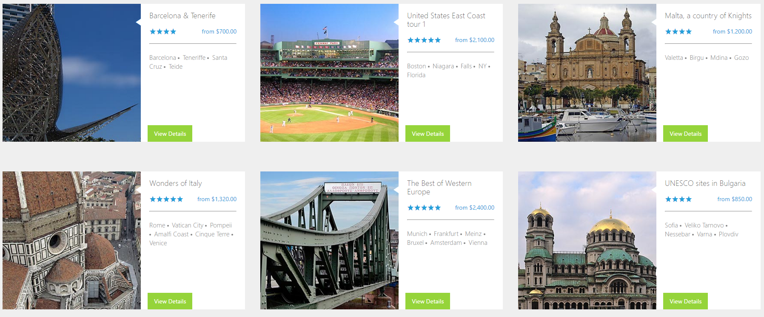
3. Home
Refer Link: http://demos.telerik.com/aspnet-mvc/tripxpert/Destinations
Home
1. Home View Page
2. Refer Site & Source Download this click
3. Create an information Button Click > go to the Create view page All members can register.
4. View Details Button > Click > go to the > Detail view page
5. Three are displayed horizontally.
Vertically, when you move down, it is automatically detected and displayed. 세로로 데이터는 아래로 이동 하면 자동으로
값을 검색하여 출력합니다. ** 이게 안되면 Pagging 기능이 표시되어야 합니다.
6. Table tblCommunity, tblCommunityAttachment tblCommunityComment
BEN Community
Home Member Project System
Logout | My Information
Communication
(5)
Create an Information
Title
Writer Date
Comment Count View Count
Title
Writer Date
Comment Count View Count
Title
Writer Date
Comment Count View Count
Title
Writer Date
Comment Count View Count
Title
Writer Date
Comment Count View Count

Slide 7
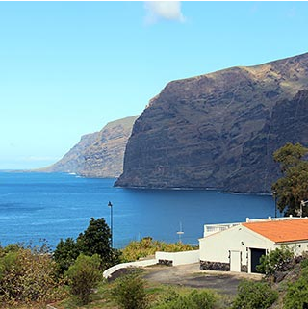

3. Home
Refer Link: http://demos.telerik.com/aspnet-mvc/tripxpert/Destinations
Home
1. Community Detail View Page > Tab 1 Information Tab
2. Refer Site: This Click This Link > Tab 2 refer (Attractions Tab)
3. Number desc (1): select tblCommunityAttachment where DisplayImgYn = 1 and CommID = this content (2): Tab Button (Information, Comment, upload Image (3): tblCommunity from ComContent → Display (4): Edit button > Click > go to the Edit View Page
(5): Delete button > Click > Alter message “정말 삭제 하시겠습니까? 삭제하면 본 컨텐츠와 관련된 모든 정보가 삭제됩니다.” Yes or No (4, 5): if(AuthorUserID = login user) → possible delete and display the this button if(ExtendAspNetUser Table. SystemAdmin = True) → possible delete and display the this button else → Hidden and can not delete (6): tblCommunityAttachment Table. > Display the FileName and AttachComment
(6-1): tblCommunityAttachment Table. > Display ImgOrOther = 0 value display if(ImgOrOther = 0) > display the image > Image Click > Layer Popup > image full size open else if (ImgOrOther = 1) > > File Name & File size display > File Name Click > Download
6. Table tblCommunity, tblCommunityAttachment tblCommunityComment
BEN Community
Home Member Project System
Logout | My Information
Communication
(1)
Display Image
Information
Comment
(2)
(3)
::
(6)
(6-1)
File Name
Attach Comment
Edit| Delete
CommentContent…………………………………………………………………………………………………………………………
……………….. ……………….. ……………….. ……………….. ……………….. ……………….. ……………….. ………………..
……………….. ……………….. ……………….. ……………….. ……………….. ………………..
……………………….
……………….. ……………….. ……………….. ……………….. ……………….. ……………….. ………………..
……………………..
……………….. ……………….. ……………….. ……………….. ……………….. ……………….. ……………….. ………………..
……………….. ……………….. ………………..
………………..
………………..
(4)
(5)
File Name
Attach Comment
File Name Display (File Size)

Slide 8
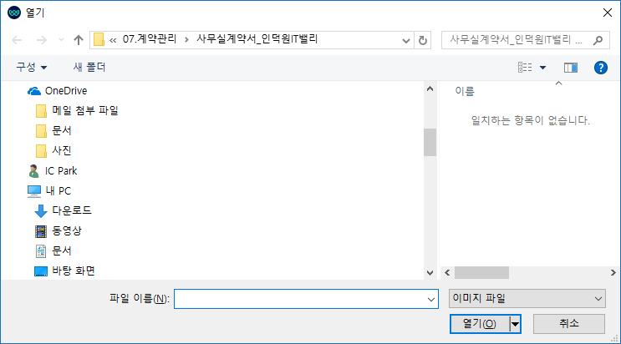

3. Home
Refer Link: http://demos.telerik.com/aspnet-mvc/tripxpert/Destinations
Home
1. Community Detail View Page > Tab 2 Comment Tab
2. Refer Site: This Click This Link > Tab 2 refer (Attractions Tab)
3. Number desc (1): select tblCommunityComment where CommID = this content (2): Tab Button (Information, Comment, upload Image (3): tblCommunityComment. ComContent → Display (4): Click > file select > stand by file > (4-2) Send button Click > File Upload (Table: tblCommentAttachment) (4-1): Enter Comment (text) (4-2): Send (Save) button (5): :: > Click > (5-1) open > Edit Click: this comment text > Change the multi line Textbox
Delete Click : Alter Message “Are you sure you want to delete it?” yes or no (6): Attach file(tblCommentAttachment )> Display if(CommentImgOrOther = 0) > display the image > Image Click > Layer Popup > image full size open else if (CommentImgOrOther = 1) > > File Name & File size display > File Name Click > Download
6. Table tblCommunity, tblCommunityAttachment tblCommunityComment
BEN Community
Home Member Project System
Logout | My Information
Communication
(1)
Display Image
Information
Comment
(2)
(3)
::
(6)
(6-1)
CommentUserName
(5)
File Name
Attach Comment
CommentContent…………………………………………………………………………………………
………………..
……………………….
……………………..
(5-1)
Edit| Delete
ComnetTIme
+
(4-2)
Send
File Name
Attach Comment
File Name Display (File Size)
(4)
(4-1)

Slide 9
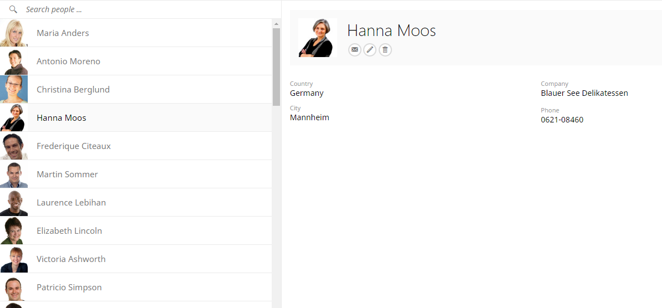
3. Home
Refer Link: http://demos.telerik.com/aspnet-mvc/tripxpert/Destinations
Member
1. Member View Page
2. Refer Site : This Link Click
3. Table: AspNetUses, ExtendAspNetUsers tblUsersPhoto
4. Number Desc (1): Member Name Search (2): Member Display (1, 2): can not search and display the Administrator only : select * from ExtendAspNetUsers Where SystemAdimin = 0 and
(2-1): Number (2) Select > display on (2-1) (2-2): if( Login User = Select user ) > display the Icon button if( Login User = SystemAdmin) > display the Icon button
else > Can not display the icon button this button click (Edit): Layer Popup open > Next Page refer
(2-3): only System Admin display this button Click > If AspNetUsers. LockOutEnable =1 > Alter Message “Lock in Enable” Yes or No -. The target user can not log in. -. Can not search and display
-. AspNetUsers. LockOutEnable = 0 update
if AspNetUsers. LockOutEnable =1 > Alter Message “Lock Out Enable” Yes or No -. The target user can log in. -. Can search and display
-. AspNetUsers. LockOutEnable = 1 update
BEN Community
Home Member Project System
Logout | My Information
(3)
Member
(1)
(2)
(2-1)
(2-2)
(2-3)
Name: First Name + space + Last Name
Email: email@email
Country: Korea
Photo: photo.png
SNS Site: www.facebook.com/.,
Recommender: Recommender
Last Login Date: 2017-04-01 17:35
Registration Date: 2017-03-01 09:15
Indroduction: ………………………………………………………………………
……………………………………………………………………………………
………………………………………………………
………………………………………………………

Slide 10
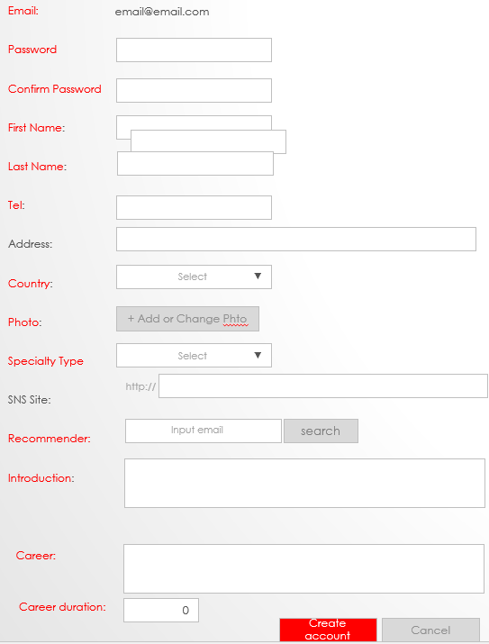
3. Home
Refer Link: http://demos.telerik.com/aspnet-mvc/tripxpert/Destinations
Member
1. Member Detail Popup Layer 2. Member Inform Update
BEN Community
Home Member Project System
Logout | My Information
(3)
Member
Name: First Name + space + Last Name
Email: email@email
Country: Korea
Photo: photo.png
SNS Site: www.facebook.com/.,
Recommender: Recommender
Indroduction: ………………………………………………………………………
……………………………………………………………………………………
………………………………………………………
………………………………………………………

Slide 11
3. Home
Refer Link: http://demos.telerik.com/aspnet-mvc/tripxpert/Destinations
Project
1. Project View Page
2. This Menu Click
> Alter Messsage “Service is in preparation.”
BEN Community
Home Member Project System
Logout | My Information
Project

Slide 12
3. Home
Refer Link: http://demos.telerik.com/aspnet-mvc/tripxpert/Destinations
System
1. System Management View Page
2. This Menu Click. > Alter Message “Only administrators can access it.”
BEN Community
Home Member Project System
Logout | My Information
System

